Slide 1

Introduction to User management and system administration in Linux

Slide 2
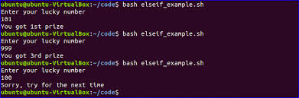
What is shell (sh)
Command language interpreter that executes commands read from a command line string, the standard input, or a specified file.

Slide 3
What is Bourne Shell (bsh)
Default interpreter for Version 7 Unix
Unix like systems have /bin/sh
Invokes the Bourne shell an interactive command interpreter and command-programming language

Slide 4

What is Bash
Bourne Again Shell (bash)
Free and enhanced version of the Bourne shell (bsh) distributed with Linux and GNU operating systems

Slide 5
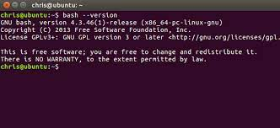
Bash Version
Default shell on Ubuntu is Bash (Bourne Again SHell)
$ bash --version

Slide 6
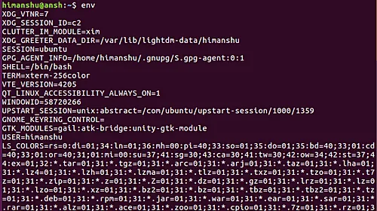
env
command to print the list of environment variables or run a utility in an altered environment without having to modify existing environment

Slide 7

User management
Creating User Accounts
Deleting User Accounts
Enabling User Accounts
Disabling User Accounts
Assigning Groups to Users
Assigning Shells to Users
Managing Passwords
managing passwords

Slide 8
User management
Add New User
adduser
Add user to the system according to CLI options and configuration information in /etc/adduser.conf
friendlier than useradd
set home_dir, group, uid, gid, shell for new user
useradd
Low level utility for adding users
low level means closest to raw data, to the kernel interface etc.
Syntax: $ sudo adduser [options] user
$ sudo useradd [options] user

Slide 9
User management
Add New Group
addgroup
Add group to the system according to CLI options and configuration information in /etc/adduser.conf
friendlier than groupadd
groupadd
Low level utility for adding groups
Syntax: $ sudo addgroup [options] [--gid ID] group
$ sudo groupadd [options] group

Slide 10
User management
Delete User
deluser
removes user from the system according to CLI options and configuration information in /etc/deluser.conf
userdel
Low level utility for deleting users
Syntax: $ sudo deluser [options] user
$ sudo userdel [options] user

Slide 11
User management
Delete Group
delgroup
removes group from the system according to CLI options and configuration information in /etc/deluser.conf
groupdel
Low level utility for deleting groups
Syntax: $ sudo delgroup [options] [--only-if-empty] group
$ sudo groupdel [options] group

Slide 12
User management
Modify User
usermod
modify a user account such as username, password, home directory, default shell etc
Syntax: $ sudo usermod [options] user

Slide 13
User management
Add user to a group
$ sudo usermod -a -G groupname username
Change user's primary group
$ sudo usermod -g groupname username
Remove user from a group
$ sudo gpasswd -d username groupname

Slide 14
User management
chsh - change login shell for a user
$ sudo chsh [options] [LOGIN}
Available shells can be seen in /etc/shells file
Change user's primary group
$ sudo usermod -g groupname username
see the groups in which the user belong using groups command
Remove user from a group
$ sudo gpasswd -d username groupname

Slide 15
User management
passwd command
Force Users to change passwords next time they login
Lock a user's password (prevent it from being used)
Set minimum number of days before changing password
Specify user when to change password
Set max number of days to use password without changing
Syntax: $ passwd [options] [LOGIN]

Slide 16
User management
Disable User
$ sudo passwd -l user //lock
Enable User
$ sudo passwd -u user //unlock
Force to change password on next login
$ sudo passwd -e user //expire
Max number of days a password remain valid
$ sudo passwd -x max_days user
number of days to show a warning to change password
$ sudo passwd -w warn_days user

Slide 17
Switch User
su username
su [options] [-] [user [arguments...]]
Can be used as a substitute user to run commands or switch user.

Slide 18
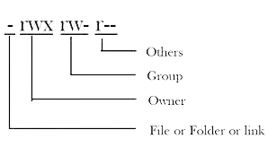
Linux permissions
User (u): Owner of the file or directory
Group (g): Group of users added to have similar permissions
Others (o): anyone else other than owner and the group

Slide 19
Linux permission Types
Read (r): Read the contents of a file
Write (w): Write and edit the contents of a file or a directory
Execute (x): Execute a program that is written in a file or directory

Slide 20
Linux permission Types
Read has value 4
Write has value 2
Execute has value 1

Slide 21
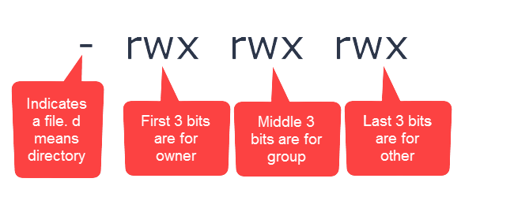
Linux permission String
10 characters in Linux Permission String (output of ls -al)
First Character is the type of the file,
The first three characters of the remaining nine characters are permissions for the user
The middle three characters are permissions for group
Last three characters are permissions for others

Slide 22
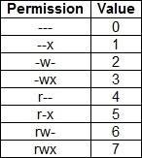
Linux permission Matrix

Slide 23
Linux permission Symbolic
User => u
Group => g
Others => o
All => a
read => r
write => w
execute => x
+ => add
- => remove
= => set

Slide 24
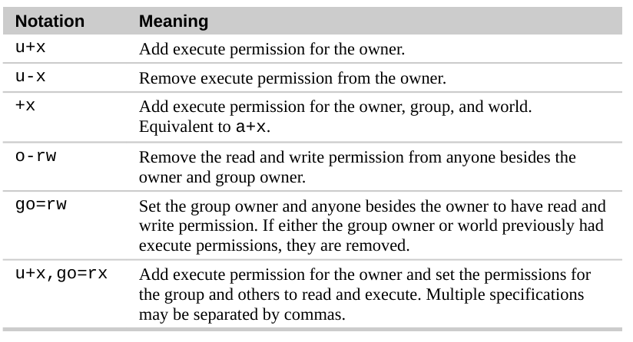
Linux permission Symbolic

Slide 25
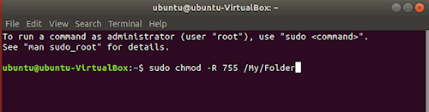
chmod - Change Mode
chmod command is used to change the permissions of a file or directory
chmod [permissions] [filename]
chmod -R [permissions] [directoryname]

Slide 26
chown - Change Ownership
chown command is used to change the ownership of a file or directory
chown [user:group] [filename]
chown -R [user:group] [directoryname]

Slide 27
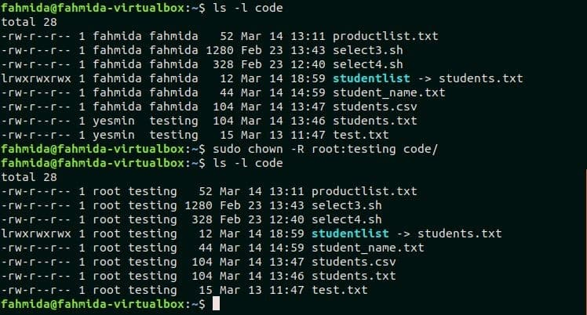
chown - Change Ownership

Slide 28
Init
Stands for Initialization
The first process started during the booting of the computer system
daemon process that continues running until the system is shutdown
A direct or indirect ancestor of all other processes
automatically adopts all orphaned processes
PID or Process ID is 1
create processes from a script stored in /etc/inittab
configuration file used by initialization system
last step of kernel boot sequence

Slide 29
Init
Init script initializes the service
responsible for initializing the system
init scripts are also called rc scripts (run command scripts)
Also used in UNIX

Slide 30
Init - services
Start a service
service [service-name] start
Stop a service
service [service-name] stop
restart a service
service [service-name] restart
reload a service
service [service-name] reload
service status
service [service-name] status

Slide 31
Init - services
Restart service if already running
service [service-name] condrestart
enable service at startup
chkconfig [service-name] on
disable service at startup
chkconfig [service-name] off
check if service is enabled at startup
chkconfig [service-name]
create new service file or modify configuration
chkconfig [service-name] add

Slide 32
Run-levels
State of init
group of processes are defined to start at the startup of OS
Mode of operation in the computer operating system
Each run level has a certain number of services started or stopped

Slide 33
Run-levels
Seven Run levels exist ($ runlevel digit or $ init digit)
0: Shuts down the system
1: single-user mode
2: multi-user mode without networking
3: multi-user mode with networking (with CLI)
4: user-definable
5: multi-user mode with networking (with GUI)
6: reboots the system to restart it

Slide 34
Run-levels
By default, Linux based systems boot on runlevel 3 or 5
user can modify preset runlevels
create new ones according to the requirements
Runlevel 2 and 4 are used for user defined runlevels
runlevel 0 and 6 aur used for shutdown and reboot the system

Slide 35
Systemd
Systemd is the new init framework
system and service manager for Linux operating systems
new distros are moving to systemd
managing services with systemd
systemctl: control system and services
journalctl: manage journal, systemd's logging system
hostnamectl: control hostname
localectl: configure locale and keyboard layout
timedatectl: set time and date
systemd-cgls: shows cgroup contents
systemadm: front-end for systemctl

Slide 36
Systemd - services
see all services (running or not)
systemctl list-units --type service --all
Start a service
systemctl start [service-name]
Stop a service
systemctl stop [service-name]
restart a service
systemctl restart [service-name]
reload a service
systemctl reload [service-name]

Slide 37
Systemd - services
see service status
systemctl status [service-name]
Restart a service if already running
systemctl condrestart [service-name]
Enable service at startup
systemctl enable [service-name]
Disable service at startup
systemctl disable [service-name]
check if service is enable at start up
systemctl is-enabled [service-name]

Slide 38
Systemd - services
create new serivce file or modify configuration
systemctl daemon-reload
systemctl halt
systemctl poweroff
systemctl reboot

